Slide 1
Programming Using the
Message Passing Paradigm
消息传递范式

Slide 2
Topic Overview
Principles of Message-Passing Programming消息传递编程的原则
The Building Blocks: Send and Receive Operations发送和接收操作
MPI: the Message Passing Interface消息传递接口
Topologies and Embedding 拓扑和嵌入
Overlapping Communication with Computation 与计算的重叠通信
Collective Communication and Computation Operations集体通信和计算操作
Groups and Communicators 组和传播者

Slide 3
Principles of
Message-Passing Programming
消息传递编程
The logical view of a machine supporting the message-passing paradigm consists of p processes, each with its own exclusive address space.
支持消息传递范式的机器的逻辑视图由p个进程组成，每个进程都有自己的
专用地址空间。
每个数据元素必须属于空间的一个分区，因此，必须显式地对数据进行分区和放置。
所有交互(只读或读/写)都需要两个进程的协作——拥有数据的进程和希望访问数据的进程。
These two constraints, while onerous, make underlying costs very explicit to the programmer.
这两个约束虽然繁重，但却使程序员非常清楚地了解底层成本。

Slide 4
Principles of
Message-Passing Programming
Message-passing programs are often written using the asynchronous or loosely synchronous paradigms.
消息传递程序通常使用异步或松散同步范式编写。
In the asynchronous paradigm, all concurrent tasks execute asynchronously.
在异步范式中，所有并发任务都是异步执行的。
在松散同步模型中，任务或任务子集同步以执行交互。在这些交互之间，任务完全异步执行。大多数消息传递程序都是使用单程序多数据(SPMD)模型编写的。

Slide 5
The Building Blocks:
Send and Receive Operations
The prototypes of these operations are as follows:
操作的原型如下：
send(void *sendbuf, int nelems, int dest)
receive(void *recvbuf, int nelems, int source)
Consider the following code segments:
P0 P1
a = 100; receive(&a, 1, 0)
send(&a, 1, 1); printf("%d\n", a);
a = 0;
send操作的语义要求进程P1接收的值必须是100，而不是0。
This motivates the design of the send and receive protocols.

Slide 6
Non-Buffered Blocking
Message Passing Operations
强制发送/接收语义的一个简单方法是，只有在安全的情况下，发送操作才返回。
在非缓冲的阻塞发送中，在接收进程遇到匹配的接收之前，操作不会返回。空闲和死锁是非缓冲阻塞发送的主要问题。
在缓冲阻塞发送中，发送方只需将数据复制到指定的缓冲区中，并在复制操作完成后返回。
数据也被复制到接收端的缓冲区中。缓冲缓解了以复制开销为代价的空闲。

Slide 7
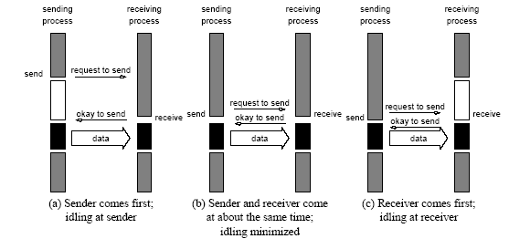
Non-Buffered Blocking
Message Passing Operations
用于非缓冲的阻塞发送/接收操作的握手。很容易看出，在发送方和接收方在类似的时间没有到达通信点的情况下，可能会有相当大的空转开销。

Slide 8
Buffered Blocking
Message Passing Operations
A simple solution to the idling and deadlocking problem outlined above is to rely on buffers at the sending and receiving ends.
解决上述空闲和死锁问题的一个简单方法是依赖发送端和接收端上的缓冲区。
发送方只需将数据复制到指定的缓冲区中，并在复制操作完成后返回。数据也必须在接收端进行缓冲。
Buffering trades off idling overhead for buffer copying overhead.
缓冲用空闲开销代替缓冲区复制开销。

Slide 9
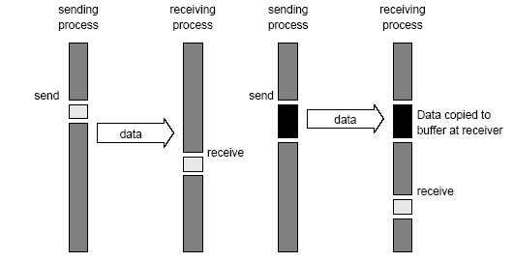
Buffered Blocking
Message Passing Operations
阻塞缓冲传输协议:(a)在通信硬件存在的情况下，在发送端和接收端使用缓冲;
(b)在缺乏通信硬件的情况下，发送方中断接收方，并将数据存储在接收方端的缓冲区中。

Slide 10
Buffered Blocking
Message Passing Operations
Bounded buffer sizes can have signicant impact on performance.
有限的缓冲区大小对性能有很大的影响。
P0 P1
for (i = 0; i < 1000; i++){ for (i = 0; i < 1000; i++){
produce_data(&a); receive(&a, 1, 0);
send(&a, 1, 1); consume_data(&a);
} }
What if consumer was much slower than producer?
如果消费者比生产者慢得多呢?

Slide 11
Buffered Blocking
Message Passing Operations
Deadlocks are still possible with buffering since receive
operations block.
由于接收操作阻塞，死锁仍然可能与缓冲有关。
P0 P1
receive(&a, 1, 1); receive(&a, 1, 0);
send(&b, 1, 1); send(&b, 1, 0);

Slide 12
Non-Blocking
Message Passing Operations
The programmer must ensure semantics of the send and receive.程序员必须确保发送和接收的语义。
This class of non-blocking protocols returns from the send or receive operation before it is semantically safe to do so.这类非阻塞协议从发送或接收操作返回，然后在语义上是安全的。
Non-blocking operations are generally accompanied by a check-status operation.非阻塞操作通常伴随着检查状态操作。
When used correctly, these primitives are capable of overlapping communication overheads with useful computations.如果使用正确，这些原语能够与有用的计算重叠通信开销
Message passing libraries typically provide both blocking and non-blocking primitives.消息传递库通常同时提供阻塞和非阻塞原语

Slide 13
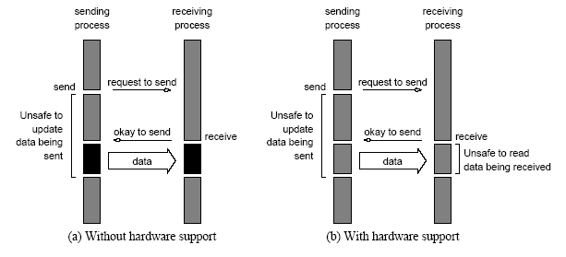
Non-Blocking
Message Passing Operations
非阻塞非缓冲的发送和接收操作
(a)在缺乏通信硬件的情况下
（b）存在通信硬件。

Slide 14
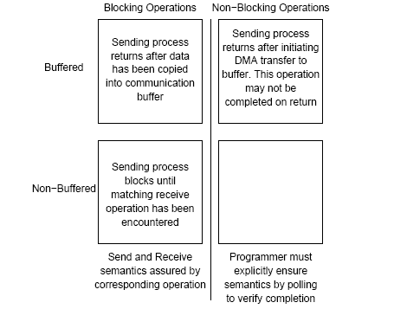
Send and Receive Protocols
发送进程返回后，初始化DMA传输到缓冲区。这个操作返回时可能没有完成
将数据复制到通信缓冲区后发送进程返回
发送进程块，直到遇到匹配的接收操作
程序员必须通过轮询来验证是否完成，从而显式地确保语义
发送和接收语义由相应的操作符保证
用于发送和接收操作的可能协议的空间。
用于发送和接收操作的可能协议的空间。

Slide 15
MPI: the Message Passing Interface
MPI defines a standard library for message-passing that can be used to develop portable message-passing programs using either C or Fortran.
The MPI standard defines both the syntax as well as the semantics of a core set of library routines.
Vendor implementations of MPI are available on almost all commercial parallel computers.
It is possible to write fully-functional message-passing programs by using only the six routines.

Slide 16
MPI: the Message Passing Interface
The minimal set of MPI routines.
MPI例程的最小集合
MPI_Init | Initializes MPI.
MPI_Finalize | Terminates MPI.
MPI_Comm_size | Determines the number of processes.
MPI_Comm_rank | Determines the label of calling process.
MPI_Send | Sends a message.
MPI_Recv | Receives a message.

Slide 17
Starting and Terminating the MPI Library
在调用其他MPI例程之前调用MPI Init
MPI_Init is called prior to any calls to other MPI routines.
Its purpose is to initialize the MPI environment. 目的是初始化MPI环境。
MPI_Finalize is called at the end of the computation,
and it performs various clean-up tasks to terminate the MPI environment.它执行各种清理任务来终止MPI环境
这两个函数的原型是:
int MPI_Init(int *argc, char ***argv)
int MPI_Finalize()
MPI_Init also strips off any MPI related command-line arguments.
MPI Init还去掉了所有与MPI相关的命令行参数
All MPI routines, data-types, and constants are prefixed by “MPI_”. The return code for successful completion is MPI_SUCCESS.
所有MPI例程、数据类型和常量都以“MPI”为前缀
成功完成的返回代码是MPI_success。

Slide 18
Communicators
A communicator 定义了一组通信域–
a set of processes that are allowed to communicate with each other.允许彼此通信的一组进程。
Information about communication domains is stored in variables of type MPI_Comm. (关于通信域的信息存储在MPI_Comm类型的变量中)
Communicators are used as arguments to all message transfer MPI routines. (一个进程可以属于许多不同的(可能重叠的)通信域。
MPI defines a default communicator called MPI_COMM_WORLD which includes all the processes.
MPI定义了一个名为MPI_COMM_WORLD的默认通信器，它包含所有进程。

Slide 19
Querying Information
The MPI_Comm_size and MPI_Comm_rank functions are used to determine the number of processes and the label of the calling process, respectively.
MPI_Comm_size和MPI_Comm_rank函数分别用于确定进程的数量和调用进程的标签。
The calling sequences of these routines are as follows:
这些例程的调用顺序如下:
int MPI_Comm_size(MPI_Comm comm, int *size)
int MPI_Comm_rank(MPI_Comm comm, int *rank)
The rank of a process is an integer that ranges from zero up to the size of the communicator minus one.
进程的rank的大小范围从0到size（ communicator-1 ）

Slide 20
Our First MPI Program
#include <mpi.h>
main(int argc, char *argv[])
{
int npes, myrank;
MPI_Init(&argc, &argv);
MPI_Comm_size(MPI_COMM_WORLD, &npes);
MPI_Comm_rank(MPI_COMM_WORLD, &myrank);
printf("From process %d out of %d, Hello World!\n",
myrank, npes);
MPI_Finalize();
}

Slide 21
Sending and Receiving Messages
在MPI中发送和接收消息的基本功能分别是：
MPI_Send and MPI_Recv,
这些例程的调用顺序如下:
int MPI_Send(void *buf, int count, MPI_Datatype datatype, int dest, int tag, MPI_Comm comm)
int MPI_Recv(void *buf, int count, MPI_Datatype datatype, int source, int tag, MPI_Comm comm, MPI_Status *status)
MPI provides equivalent datatypes for all C datatypes. This is done for portability reasons. MPI为所有C数据类型提供了等价的数据类型。这样做是为了可移植性。
数据类型MPI_BYTE 对应一个8位的字节，
数据类型MPI_PACKED corresponds to a collection of data items that has been created by packing non-contiguous data. 对应于通过打包非连续数据而创建的数据项集合。
消息标记messagetag取值可以接受从0到MPI定义的常量MPI_TAG_UB的值。

Slide 22
MPI Datatypes
MPI Datatype | C Datatype
MPI_CHAR | signed char
MPI_SHORT | signed short int
MPI_INT | signed int
MPI_LONG | signed long int
MPI_UNSIGNED_CHAR | unsigned char
MPI_UNSIGNED_SHORT | unsigned short int
MPI_UNSIGNED | unsigned int
MPI_UNSIGNED_LONG | unsigned long int
MPI_FLOAT | float
MPI_DOUBLE | double
MPI_LONG_DOUBLE | long double
MPI_BYTE
MPI_PACKED

Slide 23
Sending and Receiving Messages
MPI allows specification of wildcard arguments for both source and tag.
If source is set to MPI_ANY_SOURCE, then any process of the communication domain can be the source of the message.
If tag is set to MPI_ANY_TAG, then messages with any tag are accepted.
On the receive side, the message must be of length equal to or less than the length field specified.

Slide 24
Sending and Receiving Messages
On the receiving end, the status variable can be used to get information about the MPI_Recv operation.
在接收端，状态变量可用于获取有关MPI Recv操作的信息。
对应的数据结构包括:
typedef struct MPI_Status {
  int MPI_SOURCE;
  int MPI_TAG;
  int MPI_ERROR; };
MPI Get count函数返回接收到的数据项的精确计数。
  int MPI_Get_count(MPI_Status *status, MPI_Datatype datatype, int *count)

Slide 25
Avoiding Deadlocks避免死锁
Consider:
int a[10], b[10], myrank;
MPI_Status status;
...
MPI_Comm_rank(MPI_COMM_WORLD, &myrank);
if (myrank == 0) {
MPI_Send(a, 10, MPI_INT, 1, 1, MPI_COMM_WORLD);
MPI_Send(b, 10, MPI_INT, 1, 2, MPI_COMM_WORLD);
}
else if (myrank == 1) {
MPI_Recv(b, 10, MPI_INT, 0, 2, MPI_COMM_WORLD);
MPI_Recv(a, 10, MPI_INT, 0, 1, MPI_COMM_WORLD);
}
...
If MPI_Send is blocking, there is a deadlock. 。
如果MPI_send发送被阻塞，就会出现死锁。

Slide 26
Avoiding Deadlocks
Consider the following piece of code, in which process i sends a message to process i + 1 (modulo the number of processes) and receives a message from process i - 1 (module the number of processes).
int a[10], b[10], npes, myrank;
MPI_Status status;
...
MPI_Comm_size(MPI_COMM_WORLD, &npes);
MPI_Comm_rank(MPI_COMM_WORLD, &myrank);
MPI_Send(a, 10, MPI_INT, (myrank+1)%npes, 1, MPI_COMM_WORLD);
MPI_Recv(b, 10, MPI_INT, (myrank-1+npes)%npes, 1, MPI_COMM_WORLD);
...
Once again, we have a deadlock if MPI_Send is blocking.

Slide 27
Avoiding Deadlocks
We can break the circular wait to avoid deadlocks as follows:
int a[10], b[10], npes, myrank;
MPI_Status status;
...
MPI_Comm_size(MPI_COMM_WORLD, &npes);
MPI_Comm_rank(MPI_COMM_WORLD, &myrank);
if (myrank%2 == 1) {
MPI_Send(a, 10, MPI_INT, (myrank+1)%npes, 1, MPI_COMM_WORLD);
MPI_Recv(b, 10, MPI_INT, (myrank-1+npes)%npes, 1, MPI_COMM_WORLD);
}
else {
MPI_Recv(b, 10, MPI_INT, (myrank-1+npes)%npes, 1, MPI_COMM_WORLD);
MPI_Send(a, 10, MPI_INT, (myrank+1)%npes, 1, MPI_COMM_WORLD);
}
...

Slide 28
Sending and Receiving
Messages Simultaneously
To exchange messages, MPI provides the following function:
为了交换消息，MPI提供以下功能:
int MPI_Sendrecv(void *sendbuf, int sendcount,
MPI_Datatype senddatatype, int dest, int sendtag, void *recvbuf, int recvcount, MPI_Datatype recvdatatype, int source, int recvtag, MPI_Comm comm, MPI_Status *status)
The arguments include arguments to the send and receive
functions. If we wish to use the same buffer for both send and
receive, we can use:参数包括发送和接收函数的参数。如果我们希望发送和接收都使用相同的缓冲区，我们可以使用:
int MPI_Sendrecv_replace(void *buf, int count,
MPI_Datatype datatype, int dest, int sendtag,
int source, int recvtag, MPI_Comm comm,
MPI_Status *status)

Slide 29
Topologies and Embeddings
拓扑和嵌入
MPI allows a programmer to organize processors into logical k-d meshes.
MPI允许程序员将处理器组织成逻辑的k-d网格。
The processor ids in MPI_COMM_WORLD can be mapped to other communicators (corresponding to higher-dimensional meshes) in many ways.
MPI_COMM_WORLD中的处理器ids可以通过多种方式映射到其他通信器(对应于高维网格)。
The goodness of any such mapping is determined by the interaction pattern of the underlying program and the topology of the machine.
任何此类映射的优劣取决于底层程序的交互模式和机器的拓扑结构。
MPI does not provide the programmer any control over these mappings.
MPI没有为程序员提供对这些映射的任何控制。

Slide 30
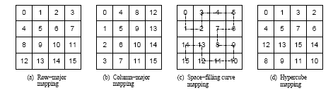
Topologies and Embeddings
将一组流程映射到二维网格的不同方法。
(a)和(b)显示了这些进程的行-列映射，(c)显示了遵循空间曲线的映射(虚线)，(d)显示了相邻进程在超立方体中直接连接的映射。

Slide 31
Creating and Using
Cartesian Topologies
创建和使用笛卡尔拓扑
We can create cartesian topologies using the function:
我们可以创建笛卡尔拓扑使用的功能:
  int MPI_Cart_create(MPI_Comm comm_old, int ndims,
  int *dims, int *periods, int reorder, MPI_Comm *comm_cart)
This function takes the processes in the old communicator and creates a new communicator with dims dimensions.此函数接受旧通信器中的进程，并创建一个具有dims维的新通信器。
Each processor can now be identified in this new cartesian topology by a vector of dimension dims.
在这个新的笛卡尔拓扑中，每个处理器现在都可以通过维数dims的向量来识别。

Slide 32
Creating and Using
Cartesian Topologies
Since sending and receiving messages still require (one-dimensional) ranks, MPI provides routines to convert ranks to cartesian coordinates and vice-versa.
由于发送和接收消息仍然需要(一维)秩，MPI提供了将秩转换为笛卡尔坐标的例程，反之亦然。
  int MPI_Cart_coord(MPI_Comm comm_cart, int rank, int maxdims, int *coords)
  int MPI_Cart_rank(MPI_Comm comm_cart, int *coords, int *rank)
The most common operation on cartesian topologies is a shift. To determine the rank of source and destination of such shifts, MPI provides the following function:
笛卡尔拓扑上最常见的操作是移位。为了确定这种转移的源和目的地的rank，MPI提供了以下功能:
  int MPI_Cart_shift(MPI_Comm comm_cart, int dir, int s_step, int *rank_source, int *rank_dest)

Slide 33
Overlapping Communication with Computation
In order to overlap communication with computation, MPI provides a pair of functions for performing non-blocking send and receive operations.
为了使计算与通信重叠，MPI提供了一组函数来执行非阻塞的发送和接收操作。
  int MPI_Isend(void *buf, int count, MPI_Datatype datatype,
  int dest, int tag, MPI_Comm comm,
  MPI_Request *request)
  int MPI_Irecv(void *buf, int count, MPI_Datatype datatype,
  int source, int tag, MPI_Comm comm,
  MPI_Request *request)
这些操作在操作完成之前返回。
函数MPI_Test由其请求标识的非阻塞发送或接收操作是否已经完成。
  int MPI_Test(MPI_Request *request, int *flag,
  MPI_Status *status)
MPI_Wait waits for the operation to complete.
  int MPI_Wait(MPI_Request *request, MPI_Status *status)

Slide 34
Avoiding Deadlocks
Using non-blocking operations remove most deadlocks. Consider:
使用非阻塞操作可以消除大多数死锁。考虑:
int a[10], b[10], myrank;
MPI_Status status;
...
MPI_Comm_rank(MPI_COMM_WORLD, &myrank);
if (myrank == 0) {
MPI_Send(a, 10, MPI_INT, 1, 1, MPI_COMM_WORLD);
MPI_Send(b, 10, MPI_INT, 1, 2, MPI_COMM_WORLD);
}
else if (myrank == 1) {
MPI_Recv(b, 10, MPI_INT, 0, 2, &status, MPI_COMM_WORLD); MPI_Recv(a, 10, MPI_INT, 0, 1, &status, MPI_COMM_WORLD);
}
...
Replacing either the send or the receive operations with non-blocking counterparts fixes this deadlock.
将发送或接收操作替换为非阻塞操作对应方修复此死锁。

Slide 35
Collective Communication and Computation Operations
MPI provides an extensive set of functions for performing common collective communication operations.
Each of these operations is defined over a group corresponding to the communicator.
All processors in a communicator must call these operations.

Slide 36
Collective Communication Operations
集体交流操作
The barrier synchronization operation is performed in MPI using:
  int MPI_Barrier(MPI_Comm comm)
The one-to-all broadcast operation is:一对所有的广播操作是:
  int MPI_Bcast(void *buf, int count, MPI_Datatype datatype, int source, MPI_Comm comm)
The all-to-one reduction operation is:
  int MPI_Reduce(void *sendbuf, void *recvbuf, int count, MPI_Datatype datatype, MPI_Op op, int target, MPI_Comm comm)

Slide 37
Predefined Reduction Operations
预定义的还原操作
Operation | Meaning | Datatypes
MPI_MAX | Maximum | C integers and floating point
MPI_MIN | Minimum | C integers and floating point
MPI_SUM | Sum | C integers and floating point
MPI_PROD | Product | C integers and floating point
MPI_LAND | Logical AND | C integers
MPI_BAND | Bit-wise AND | C integers and byte
MPI_LOR | Logical OR | C integers
MPI_BOR | Bit-wise OR | C integers and byte
MPI_LXOR | Logical XOR | C integers
MPI_BXOR | Bit-wise XOR | C integers and byte
MPI_MAXLOC | max-min value-location | Data-pairs
MPI_MINLOC | min-min value-location | Data-pairs

Slide 38
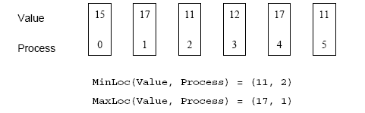
Collective Communication Operations
The operation MPI_MAXLOC combines pairs of values (v_{i}, l_{i}) and returns the pair (v, l) such that v is the maximum among all v_{i} 's and l is the corresponding l_{i} (if there are more than one, it is the smallest among all these l_{i} 's).
MPI_MINLOC does the same, except for minimum value of v_{i}.
MPI_MAXLOC操作将值对(vi, li)组合在一起，并返回值对(v, l)，使得v是所有vi中的最大值，l是相应的li(如果有多个li，则是所有li中最小的一个)。
除了取vi的最小值之外，MPI_MINLOC执行相同的操作。
An example use of the MPI_MINLOC and MPI_MAXLOC operators.

Slide 39
Collective Communication Operations
MPI datatypes for data-pairs used with the MPI_MAXLOC and MPI_MINLOC reduction operations.
与MPI MAXLOC一起使用的数据对的MPI数据类型和MPI MINLOC还原操作。
MPI Datatype | C Datatype
MPI_2INT | pair of ints
MPI_SHORT_INT | short and int
MPI_LONG_INT | long and int
MPI_LONG_DOUBLE_INT | long double and int
MPI_FLOAT_INT | float and int
MPI_DOUBLE_INT | double and int

Slide 40
Collective Communication Operations
If the result of the reduction operation is needed by all processes, MPI provides:
如果所有过程都需要还原操作的结果，MPI提供:
  int MPI_Allreduce(void *sendbuf, void *recvbuf,
  int count, MPI_Datatype datatype, MPI_Op op, MPI_Comm comm)
To compute prefix-sums, MPI provides:
为了计算前缀和，MPI提供:
  int MPI_Scan(void *sendbuf, void *recvbuf, int count, MPI_Datatype datatype, MPI_Op op,
  MPI_Comm comm)

Slide 41
Collective Communication Operations
The gather operation is performed in MPI using:采集操作
  int MPI_Gather(void *sendbuf, int sendcount,
  MPI_Datatype senddatatype, void *recvbuf,
  int recvcount, MPI_Datatype recvdatatype,
  int target, MPI_Comm comm)
MPI还提供了在所有进程中收集数据的MPI Allgather函数。
  int MPI_Allgather(void *sendbuf, int sendcount, MPI_Datatype senddatatype, void *recvbuf,
  int recvcount, MPI_Datatype recvdatatype,
  MPI_Comm comm)
The corresponding scatter operation is:相应的分散操作为:
  int MPI_Scatter(void *sendbuf, int sendcount,
  MPI_Datatype senddatatype, void *recvbuf,
  int recvcount, MPI_Datatype recvdatatype,
  int source, MPI_Comm comm)

Slide 42
Collective Communication Operations
The all-to-all personalized communication operation is performed by:全部对全部个性化的通信操作由:
  int MPI_Alltoall(void *sendbuf, int sendcount, MPI_Datatype senddatatype, void *recvbuf,
  int recvcount, MPI_Datatype recvdatatype, MPI_Comm comm)
Using this core set of collective operations, a number of programs can be greatly simplified.
使用这组核心的集体操作，可以极大地简化许多程序。

Slide 43
Groups and Communicators
In many parallel algorithms, communication operations need to be restricted to certain subsets of processes.在许多并行算法中，通信操作需要限制在进程的某些子集中。
MPI提供了将属于通信器的进程组划分为对应于不同通信器的子组的机制。
The simplest such mechanism is:这种机制最简单的是:
  int MPI_Comm_split(MPI_Comm comm, int color, int key, MPI_Comm *newcomm)
.该操作按颜色对处理器进行分组，并对键上的结果组进行排序。

Slide 44
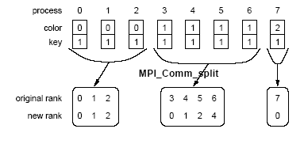
Groups and Communicators
Using MPI_Comm_split to split a group of processes in a communicator into subgroups.
使用MPI comm_split来分割一组进程在通信器中分成子组。

Slide 45
Groups and Communicators
In many parallel algorithms, processes are arranged in a virtual grid, and in different steps of the algorithm, communication needs to be restricted to a different subset of the grid.
在许多并行算法中，进程被安排在一个虚拟网格中，在算法的不同步骤中，通信需要限制在网格的不同子集中。
MPI provides a convenient way to partition a Cartesian topology to form lower-dimensional grids:
MPI提供了一种方便的方法来划分一个笛卡尔拓扑，形成低维网格:
  int MPI_Cart_sub(MPI_Comm comm_cart, int *keep_dims, MPI_Comm *comm_subcart)
If keep_dims[i] is true (non-zero value in C) then the ith dimension is retained in the new sub-to.如果keep dims [i]为true (C中的非零值)，则在新拓扑中保留第i维。
pology The coordinate of a process in a sub-topology created by MPI_Cart_sub can be obtained from its coordinate in the original topology by disregarding the coordinates that correspond to the dimensions that were not retained.
MPI_Cart_sub拓扑中进程的坐标可以通过忽略与未保留维度对应的坐标而从原始拓扑中获得。

Slide 46
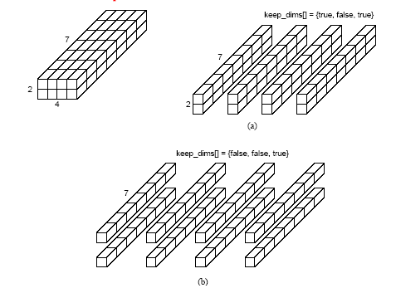
Groups and Communicators
Splitting a Cartesian topology of size 2 x 4 x 7 into (a) four
subgroups of size 2 x 1 x 7, and (b) eight subgroups of size 1 x 1 x 7.

